Slide 1

Advanced Web Technologies Front: React
10/12/2018
ISEP : React

Slide 2
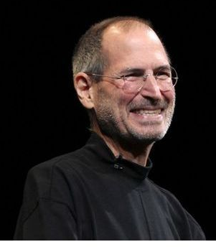
Reminder…
What we talked about last week…
Separation of Front and Back
NPM for packages
Webpack for building
Babel for modern JavaScript
ES 2015 for coding
But there is one more thing…
ISEP : React

Slide 3
Libs & Frameworks
Why use a lib of a framework?
The Front is no longer helped by the server…
It provides organisation
It is made to manipulate the DOM efficiently
Because you don’t want to reinvent the wheel!
Those you need to forget…
Those you should pick…
Jquery (non-modern)
AngularJS (replaced)
Knockout (not maintained)
Angular 6
Vue.js
React
ISEP : React

Slide 4

React
What is React?
What is React?
A modern JavaScript library focusing on rendering
Developed and used by Facebook
Cons…
Pros…
A unique syntax…
Incompatibility with non-React packages
A unique syntax…
Facebook!
PERFORMANCES!!!
Virtual DOM
ISEP : React

Slide 5
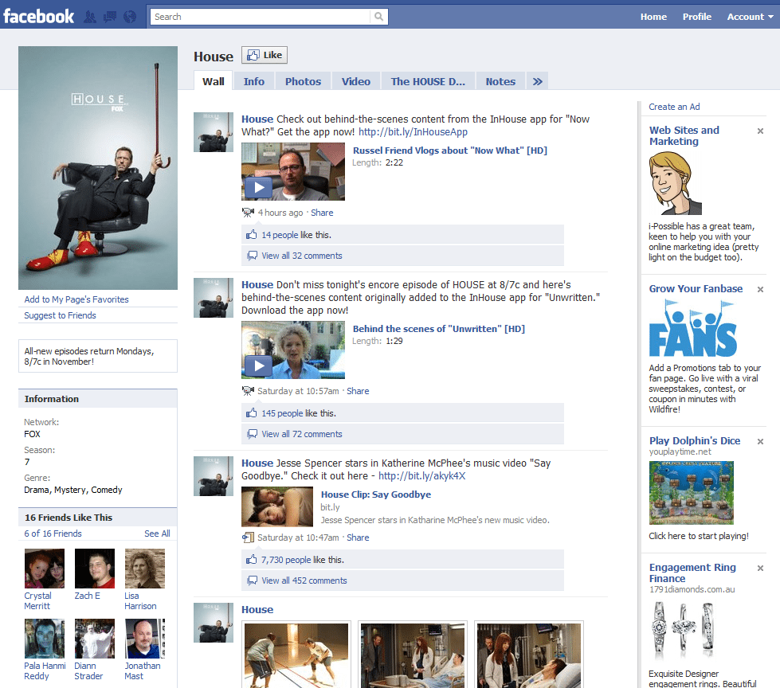
Think ‘React’
(Image taken from Google…)
ISEP : React

Slide 6
Seting up React
NPM package create-react-app
How to install it globally:
How to use it (it takes some time…):
It creates:
A solid configuration
Basic files for your application
Basic files for writing tests (!)
ISEP : React

Slide 7

React
ISEP : React

Slide 8
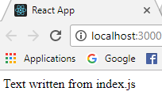
React: basic rendering
Index.html:
We only need this:
Index.js:
ISEP : React

Slide 9

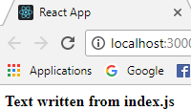
React: JSX
Always remember: JSX is NOT HTML, it just looks like it!
ISEP : React

Slide 10
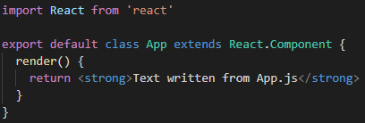
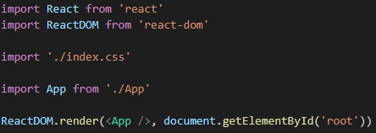
React: Writing a component
App.js:
index.js:
ISEP : React

Slide 11
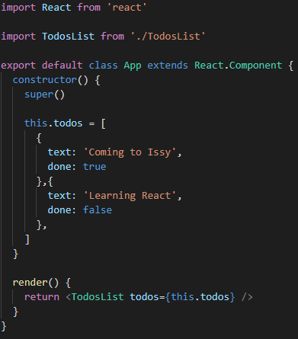
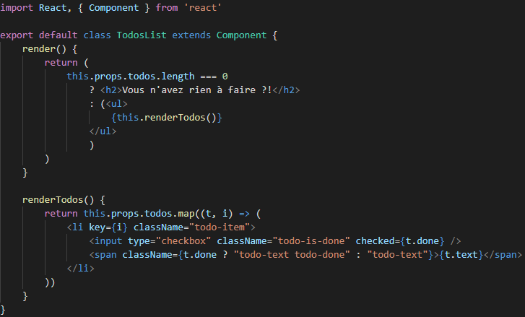
React: props
App.js:
TodosList.js:
ISEP : React

Slide 12
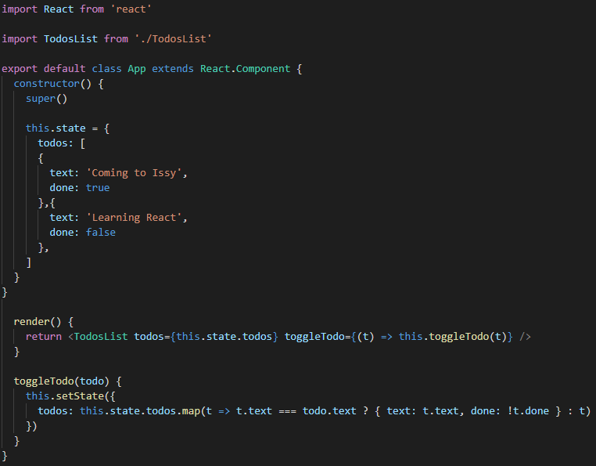
React: state
App.js:
TodosList.js:
ISEP : React

Slide 13
React: What’s next?
Good practices we will see next week
PropTypes
Stateless Components
The importance of immutability
Spread operator
Unit tests (!)
ISEP : React

Slide 14

Today’s TP!
What you will have to do:
A Web page allowing you to (un)select a song from a list
What will be evaluated:
Features correctly developed
Code quality !
Code quality !!
Code quality !!!
Ergonomics/design
ISEP : React

Slide 15

That’s finally it! Have fun ☺
10/12/2018
ISEP : React

